Slide 1
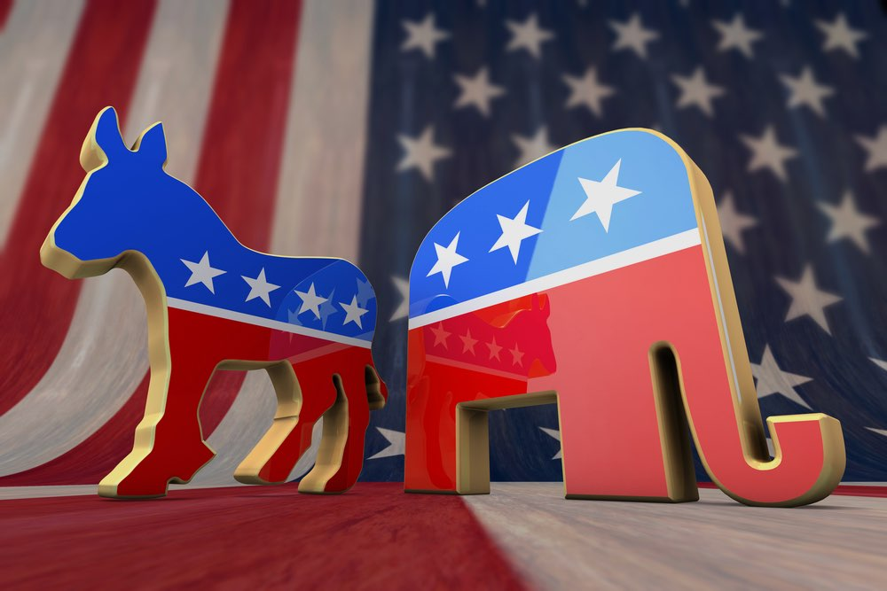
2016 US Election
Prediction and Visualization
Team 1

Slide 2
Data
Kaggle
US Census Bureau
Dimensions:
Counties: 3143 x 54
Results: 24611 x 8

Slide 3
Goals
1
2
3
Predict
Party
Winners
Data
Important features
Visualization

Slide 4
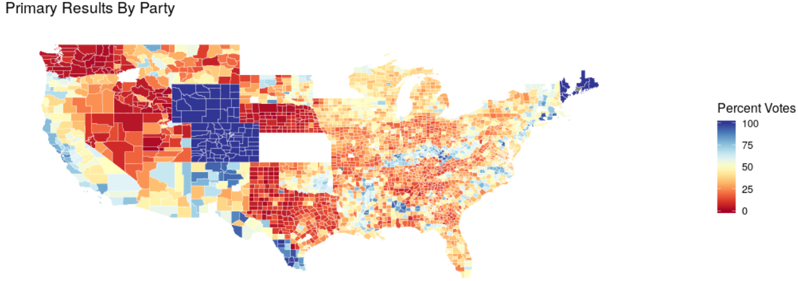
Data Visualization

Slide 5
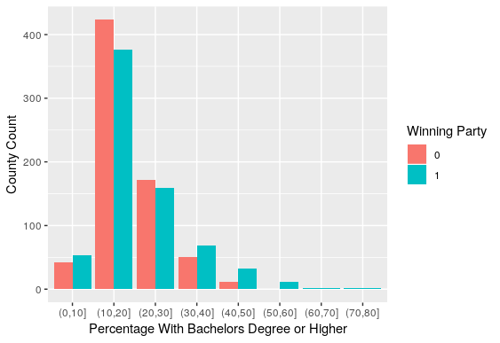
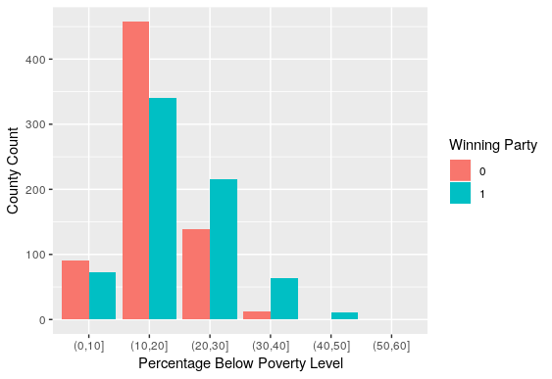
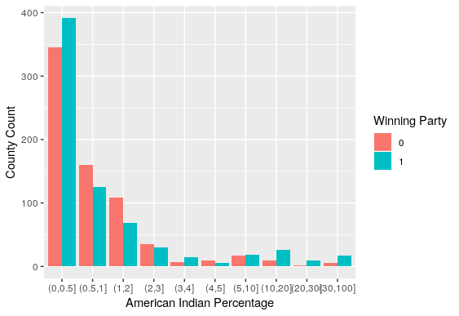
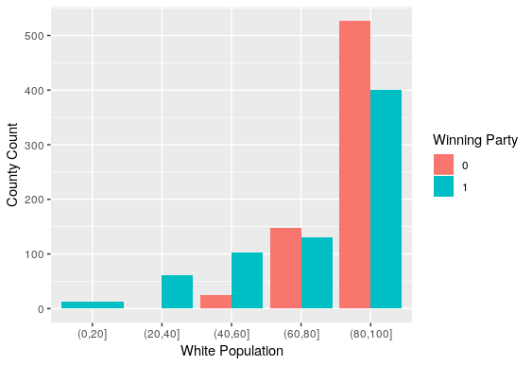
Is there a correlation between
education level & the wining party?
Is there a correlation between
poverty level & winning party?
Is there a correlation between
race & wining party?

Slide 6
Model
Establishment
Data cleaning & Normalization
Fill blanks with mean value
Normalized by population
Removed wrong data
Using logistic regression to pick significant variable
Stepwise
VIF test
Significant test
Build a neural network to analyze the problem
Balanced data using
random choice
Determine the important factors and check the accuracy

Slide 7
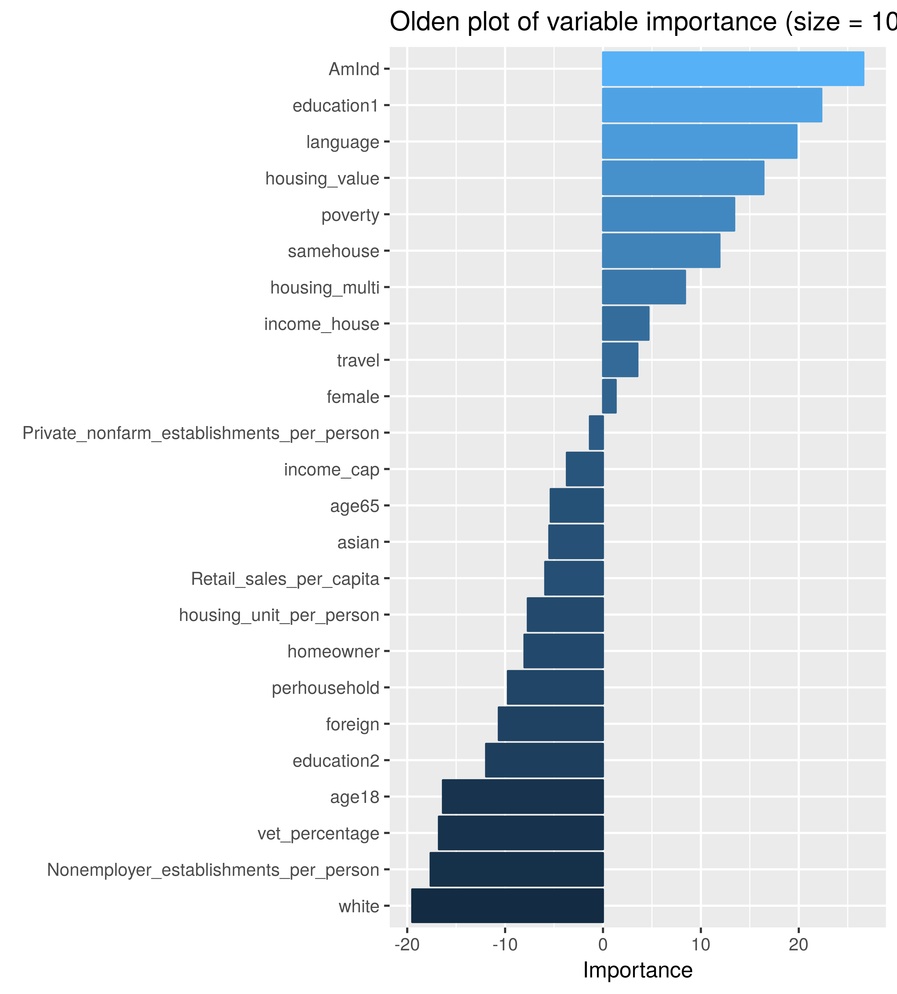
Neural Network
1400 Test Samples:
702 Republican 701 Democrats
 | Predicted Republicans | Predicted Democrats
True Republicans | 614 | 88
True Democrats | 113 | 588
Say Something here to describe your idea。
Accuracy rate = 85.67%
Precision rate = 86.98%
Recall rate = 83.88%
F1 Score = 0.854
Highly Predictive Model

Slide 8
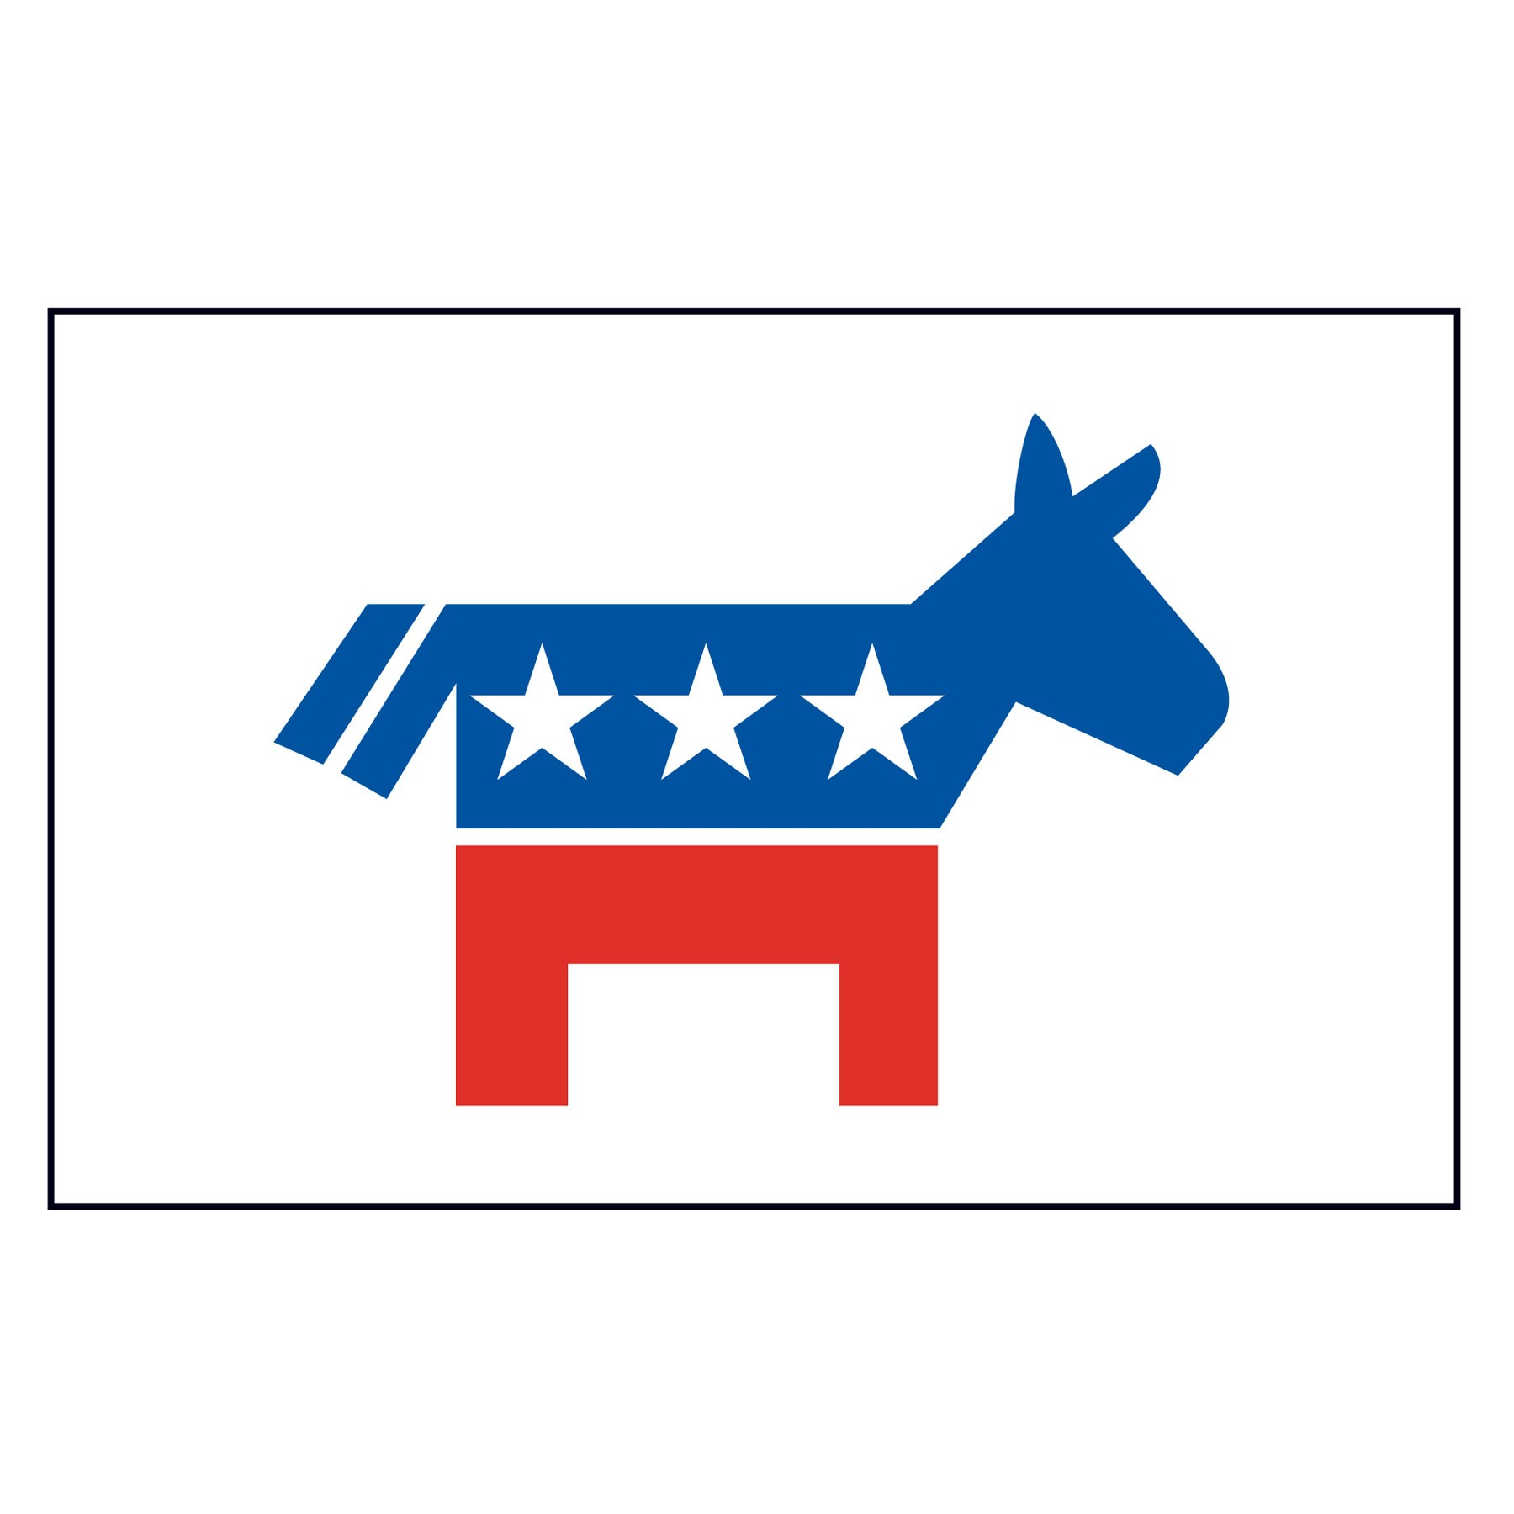
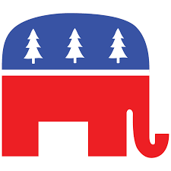
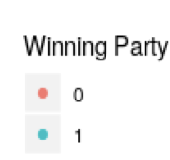
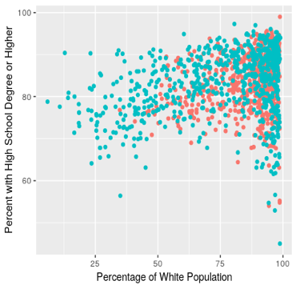
Significant variable
Democrats
Republicans
More White
Higher Education level
Higher
Unemployment
Rate
More American Indian
Higher Foreign
Language
usage rates
Higher Veteran
percentage

Slide 9
Predictions
Can we predict how California and Texas will vote using our model?
Can we predict how America as a whole will vote using our model?

Slide 10

Predictions
Demographic information for CA, TX, and USA
White percentage
American Indian percentage
Poverty percentage
Bachelor degree or above
CA: 72.5%
TX: 81.8%
USA: 73.3%
CA: 1.59%
TX: 1.00%
USA: 1.32%
CA: 15.8%
TX: 20.0%
USA: 16.1%
CA: 31.2%
TX: 25.6%
USA: 29.4%
Probability to vote Democrat based on our model：
CA: 99.98%
TX: 2.3%
USA: 99.6%

Slide 11
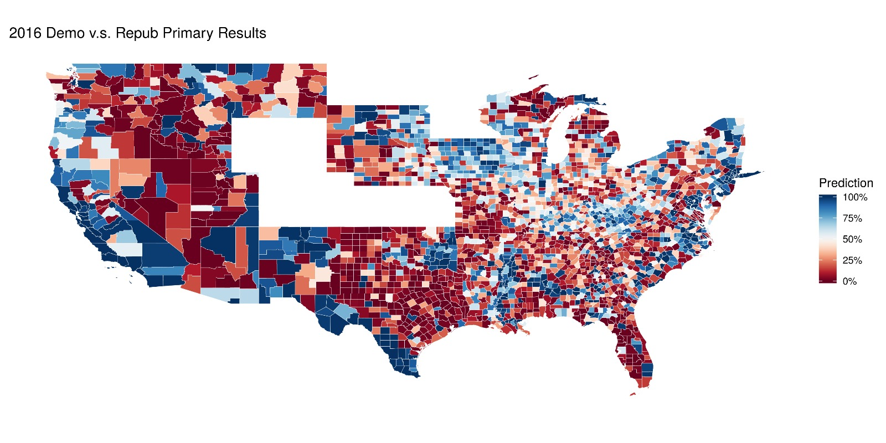
Stable state prediction
Top 3 states most likely to vote Democrat:
California 99.989%
New Jersey 99.983%
New York 99.980%
Bottom 3 states most likely to vote Republican:
Utah 0.56%
South Dakota 2.72%
Arkansas 3.78%

Slide 12
Swing state prediction
Do common swing states appear to “swing” according to our model?
Common Swing States:
Florida, Michigan, Minnesota, Ohio, Nevada,
North Carolina, Pennsylvania, Virginia, and Wisconsin
Probability to vote Democrat based on our model:
Wisconsin 70% Minnesota 60% Arizona 50%
North Carolina 80% Virginia 95% Nevada 99%
Other swing states in our prediction model included:
Indiana 50%
Kentucky 57%
South Carolina 45%

Slide 13
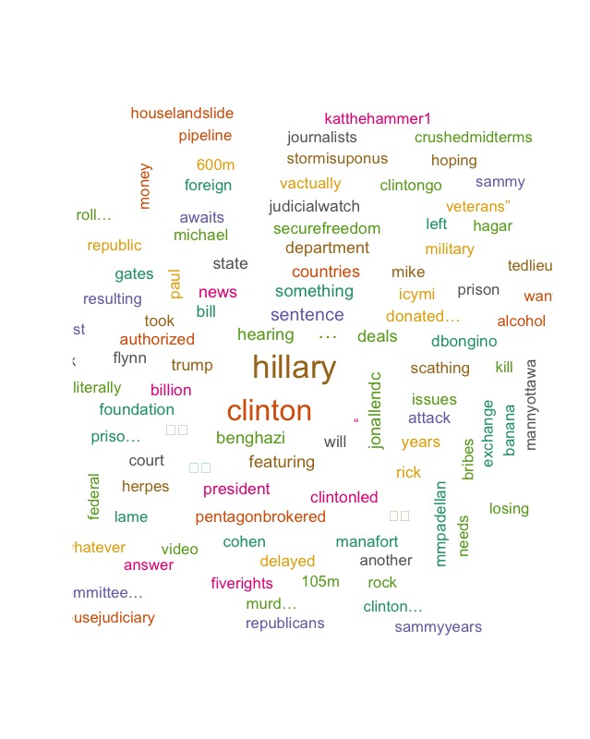

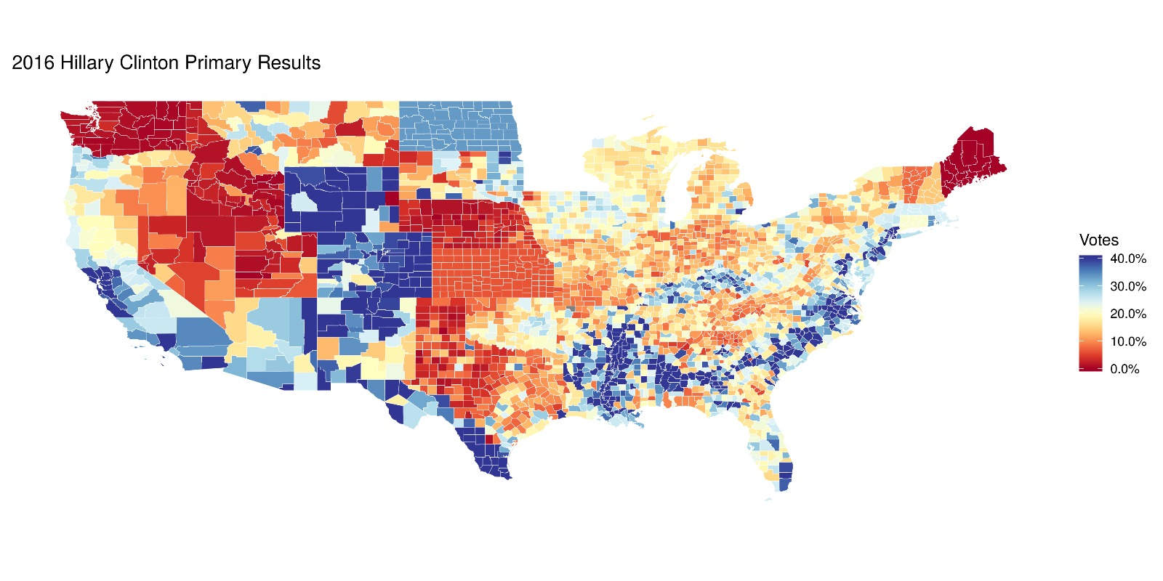
Hillary
Clinton
Foundation Fraud
Scathing

Slide 14
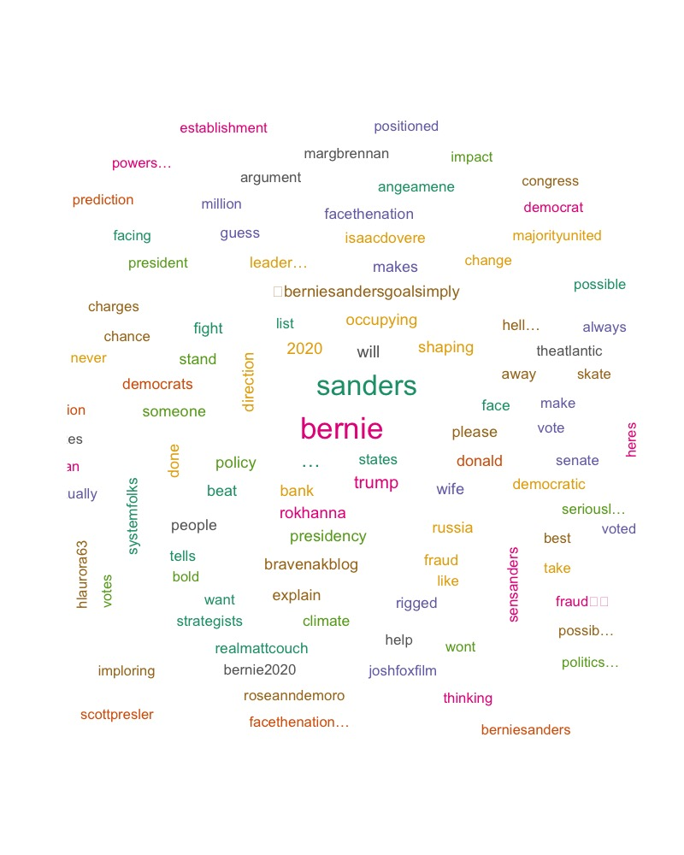
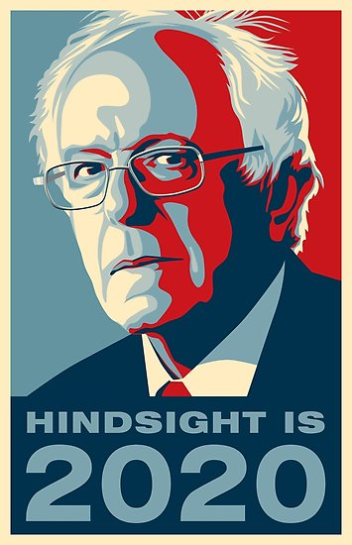
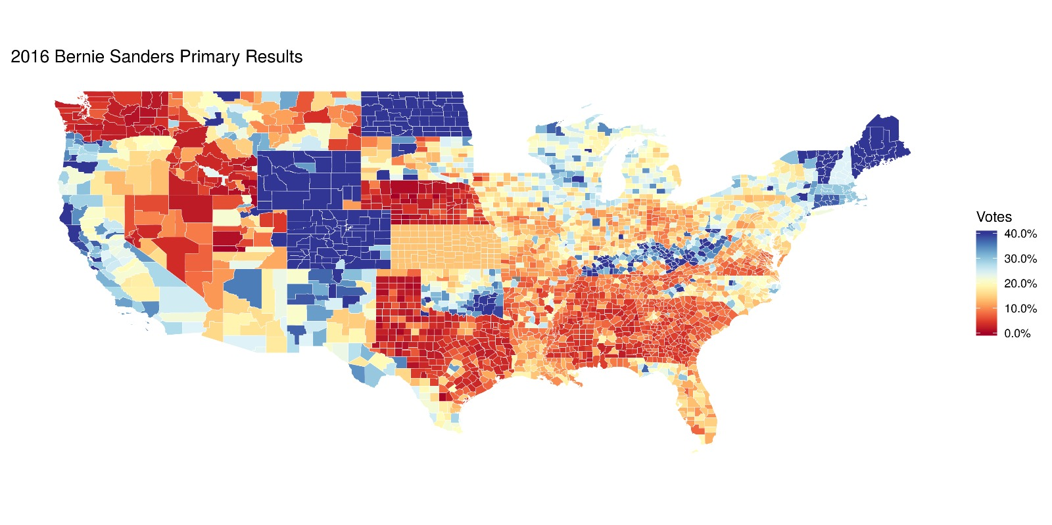
Bernie
Sanders
Bernie2020

Slide 15
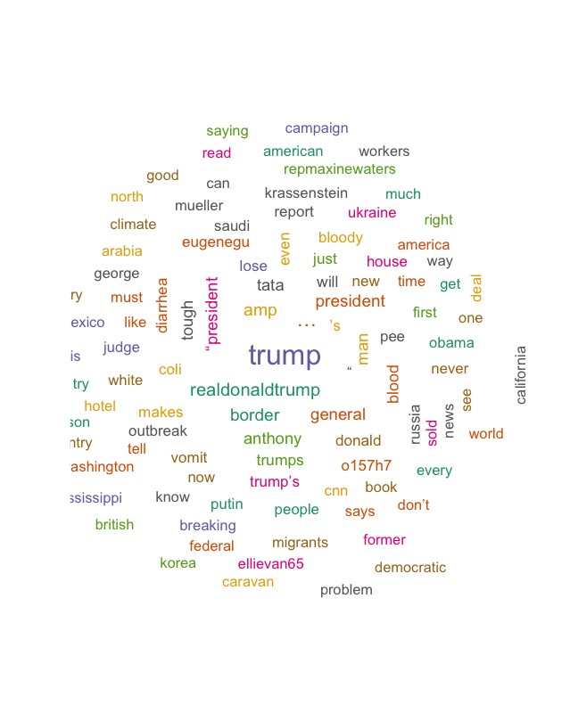

Donald
Trump
Border
Migrants
Putin

Slide 16
(
(
(
(
(
(
(
(
(
(
(
(
(
(
(
LOGO
Here is your
Q&A

